Slide 1
Discovering Enrollment Patterns for Course Planning
12.04.25
Tasmia Alamgir Zubaer Chowdhury Mateo Goldman

Slide 2
Table of Contents
Data Mining
1.
Introduction & Motivation
2.
Cleaning & Preprocessing
3.
Feature Engineering
4.
Modeling
5.
Conclusion

Slide 3

Introduction
Data Mining
Motivation
College students notoriously face significant stress when planning their academic trajectory, often leading to inefficiencies in course selection.
30% of U.S. college students change their major within three years.
Only 46% of students graduate with a bachelor's degree within four years.
High Stress Registration uncertainty creates significant anxiety and burdens academic advisors.

Slide 4
Project Goal
Introduction
Data Mining
Offer better support to student, faculty and staff by making enrollment and academic planning for efficient for schools, colleges and universities.
Advisors
Students
Automating the discovery of course popularity and seat availability
Reducing repetitive query burden on academic advisors, allowing them to focus on guidance pivotal to student success.
Provide students with transparent metrics:
Course Ratings (Fill Speed)
Dropout Rates (Professor Quality)
Enrollment Probability

Slide 5
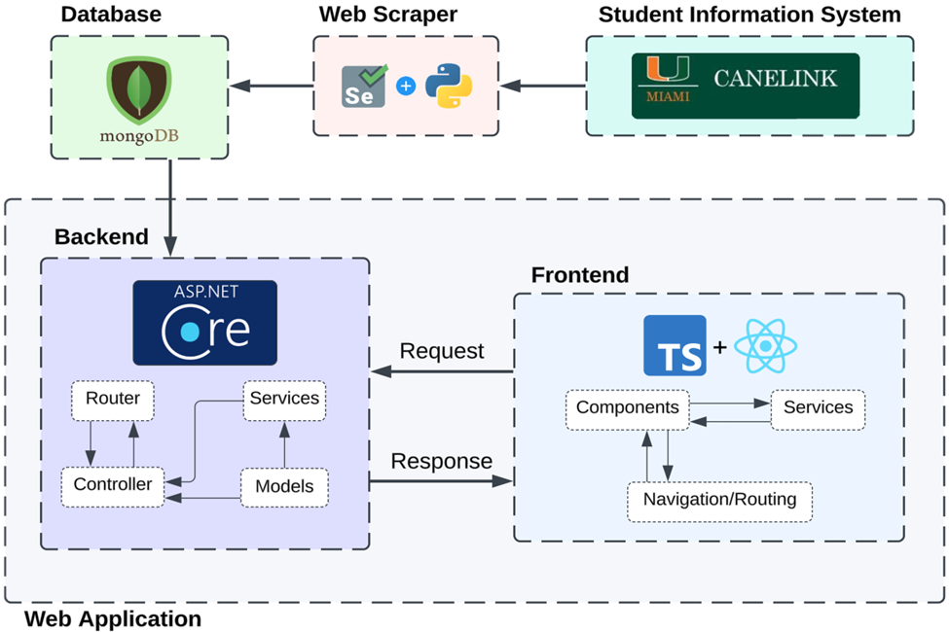
Initial Database and Scrapping
Introduction
Data Mining
Course information data from University of Miami’s Student Information System was scrapped, capturing enrollment changes in real time for multiple semesters.
We only analysed the exported dataset in CSV format from MongoDB time-series data cluster.

Slide 6
Table of Contents
Data Mining
1.
Introduction & Motivation
2.
Cleaning & Preprocessing
3.
Feature Engineering
4.
Modeling
5.
Conclusion

Slide 7
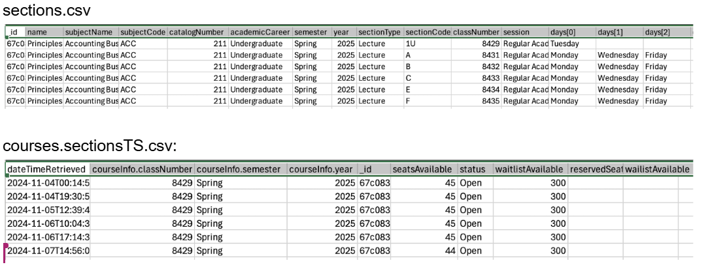
Dataset Overview
Processing
We imported the static course sections file, which contains one row per class with metadata such as subject, catalog number, capacity, and delivery mode and the time-series file, which tracks how the enrollment for each course changes over time as open seats are taken.
Initial State:

Slide 8
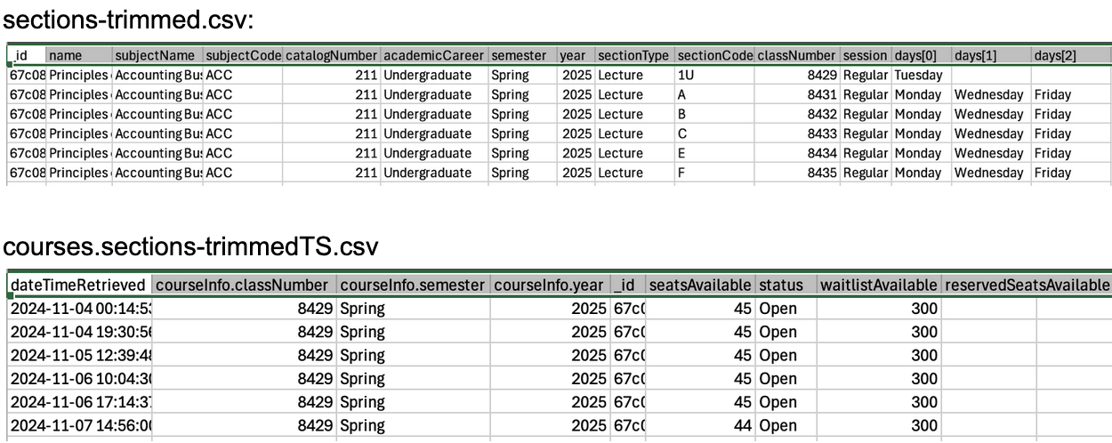
Processing
We removed empty, irrelevant, or low-quality columns/rows from both datasets and save the cleaned versions for downstream analysis.
Section CSV size reduced from 13.5MB to 3.5MB and time series CSV by 3MB
Final State:

Slide 9
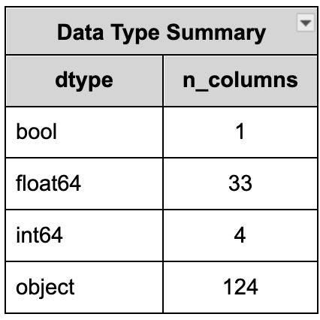
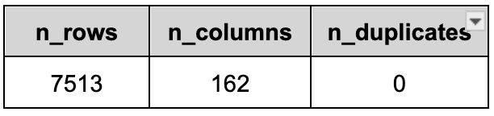
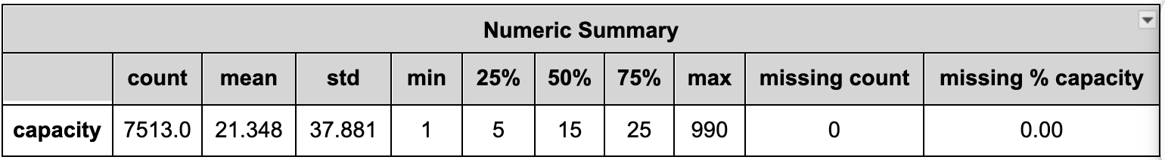
Data Validation Report
Processing
A data quality report summarizing row/column counts, duplicates, and identify 31 fully empty columns that can be safely ignored.
Data Validation Checks
1. All id values are unique (7513 unique values)
2. academicCareer values are all either 'Graduate', or ‘Undergraduate'
3. year value are all '2025'
4. semester value are all 'Spring'

Slide 10
Cleaning & Cohort Selection
Processing
Cohort Filtering
Data Quality Repair
Restricted analysis to Spring 2025 semester
Merging incorrect column names into the correct field
(i.e. wailistAvailable -> waitlistAvailable)
Temporal Structuring
Dimensions
Ordered data for time-series analysis
- Grouped by classNumber
- Sorted by dateTimeRetrieved
Unique Course Sections: 7,513
Time-Series Observations: 1,060,659

Slide 11
Data Quality and Aggregation
Processing
Reporting Engine to profile time-series observations and static records
Ensured dateTimeRetrieved is increasing for every course
100% Uniqueness of Course and Section IDs
Removal of 31 empty columns, reducing dimensionality
  Unused instructor slots
  Incorrect calendar fields
Intersection Merge strategy
  Keys: classNumber + semester + year
  Aligning static details with the dynamic logs of enrollment
Overlapping columns are renamed with a suffix (-TS), preserving the original and new dynamic polling history
Nested Data Structure construction
  seatsAvailable becomes [45, 45, 44, …]

Slide 12
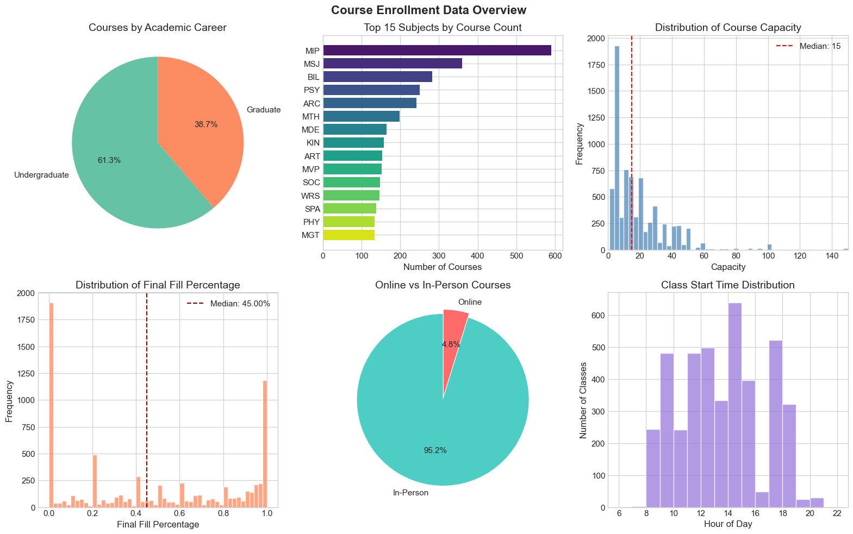
Cleaned Dataset Overview
Noise Reduction
  Ghost/Cancelled courses removed to prevent model bias
  5,612 active courses with 798,136 time-series observations
Notes:
Our data reveals a critical problem: half of all courses at University of Miami don't reach 50% capacity, while others fill completely - there's barely any middle ground. With a median capacity of just 15 students, every enrollment decision matters. This bimodal pattern validates our project's core value: students urgently need to know which courses will fill fast during registration, and administrators need better tools to optimize course offerings and reduce the massive resource waste from under-enrolled courses.
Even though the typical course is small (median capacity ≈ 15 seats), the median final fill is only about 45%. And the histogram shows a very spiky, almost bimodal pattern: lots of sections end either completely empty (0% fill) or completely full (100% fill), with relatively fewer courses in the middle.”
That’s a nice hook because it:
Suggests large inefficiencies in seat allocation (many empty seats while other sections are packed).
Naturally motivates your project: predicting demand / enrollment so sections can be planned and balanced better.

Slide 13
Table of Contents
Data Mining
1.
Introduction & Motivation
2.
Cleaning & Preprocessing
3.
Feature Engineering
4.
Modeling
5.
Conclusion

Slide 14


Capturing The Temporal Dynamics
Feature Engineering
Data Mining
Mapped linear time to Sine/Cosine coordinate pairs to ensure model understands that Sun night is adjacent to Monday morning
Velocity, fill_velocity_per_day, and Acceleration, fill_acceleration, quantifying the surging of registrations
Notes:
Enrollment Momentum. It wasn't enough to simply know if a class was full; we needed to know how fast it was filling. We calculated the 'Velocity'—the rate of filling per day—and the 'Acceleration'—how that rate changes. allows us to distinguish between a class that is full because it's popular (high velocity) versus a class that is full simply because it's small

Slide 15
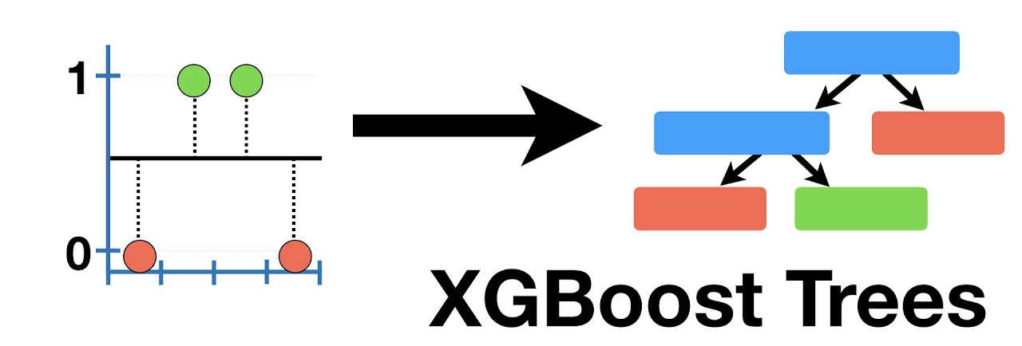
Dataset Construction Modeling
Feature Engineering
Data Mining
Constructed final training matrix, defining target variable as the fill percentage
One-Hot Encoding converts text to binary vectors
Final scrubbing to ensure ready for XGBoost algorithm
Notes:
to standardize demand metrics across courses selected fill percentage instead of raw seat counts

Slide 16
XGBoost
Selected for its ability to handle non-linear fill rates and robustness to missing data.
Leakage Prevention Strategy:
Excluded the "current state" features (like Current Seats Taken). Representing the "answer" at time t.
Included only Lagged Features and Rolling Statistics.
Training Split:
Training on the first 80% of the timeline, testing on the final 20%.
Mean Absolute Error (MAE) target tolerance of +- 5%.
Notes:
Used XGBoost to predict class sizes, focusing on avoiding 'cheating’ since we would not know the current days full numbers when predicting next week. So we hid that data from the model. Forcing it to learn purely from historical data—looking at how fast seats were filling days ago. Aiming to get our forecasts within 5% of the actual student count.”
1. Gradient Boosting Framework
XGBoost builds an ensemble of decision trees sequentially, where each new tree corrects the errors of the previous ones.
This results in:
High predictive power
Low bias
Strong ability to capture complex patterns
2. Handles Nonlinearity Well
Decision-tree-based models naturally capture nonlinear relationships without requiring feature transformations.
3. Regularization to Reduce Overfitting
XGBoost includes L1 (Lasso) and L2 (Ridge) regularization directly in the model.
This helps:
Prevent overfitting,
Improve generalization,
Make classification more robust.
4. Built-in Handling of Missing Values
XGBoost automatically learns the best direction (left or right) to take when a feature is missing.
This is especially useful in real-world classification datasets.
5. Weighted and Probabilistic Outputs
XGBoost supports:
Binary classification
Multiclass classification
Class imbalance handling through scale_pos_weight
Probability outputs through logistic transformation
This flexibility makes it strong across many classification applications.

Slide 17
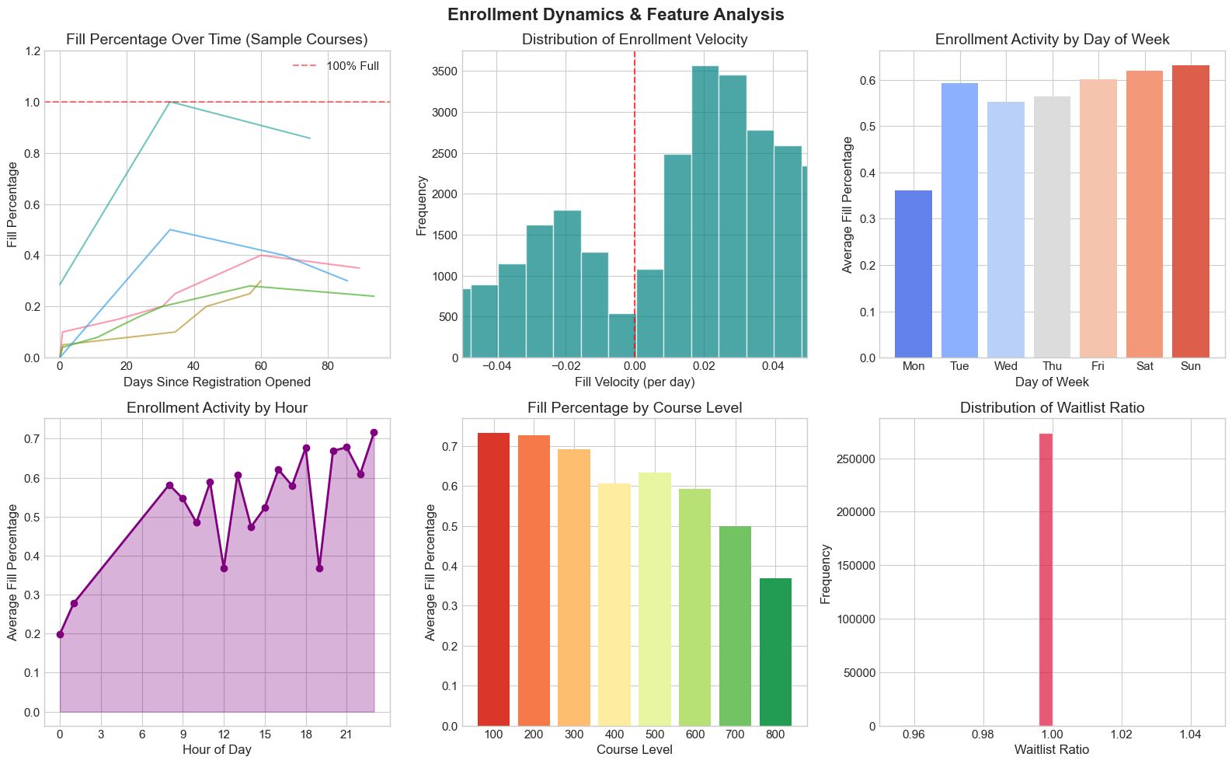
Feature
Engineering
Data Mining

Slide 18
Table of Contents
Data Mining
1.
Defining the Problem
2.
Making Observations
3.
Feature Engineering
4.
Modeling
5.
Conclusion

Slide 19
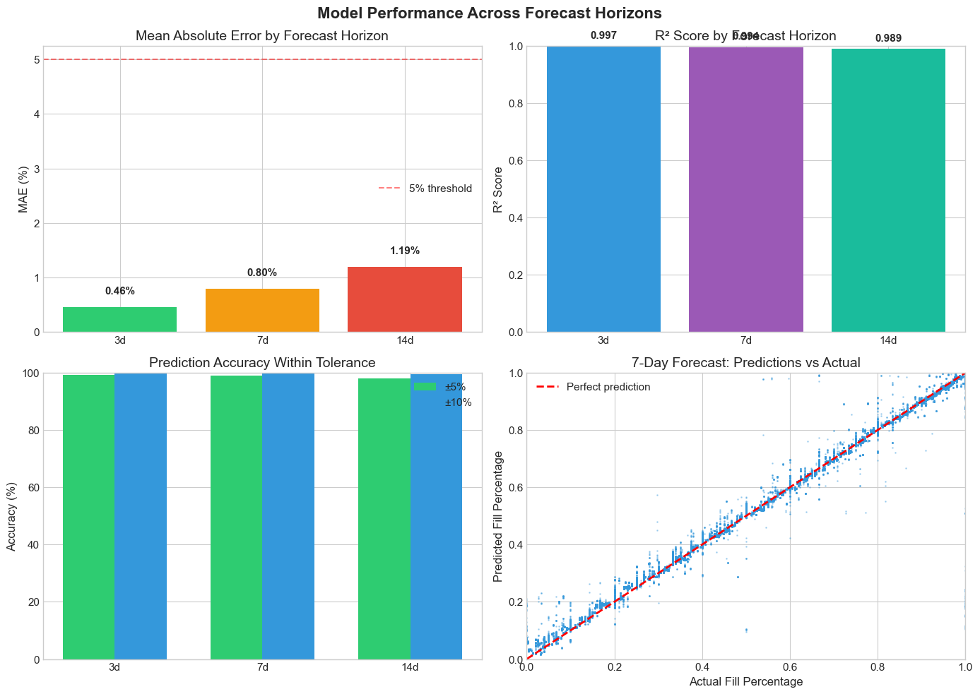
Forecasting Model
Modeling
Data Mining
Predicting enrollment 3, 7, and 14 days out
Model only sees past history. NOT current state
Very high accuracy for short and long term forecasts
The momentum is the single best predictor!
Time Series Forecasting
XGBoost Classifier + Regressor
Ranking / Scoring
Notes:
For modelling, we are classifying popular courses into 3 categories:
3 days to fill, 7 days to fill and, 14 days to fill
We also performed a 7 day forecast and compare between predicted vs actual in the scatterplot
Our model is quite accurate within 5% tolerance

Slide 20
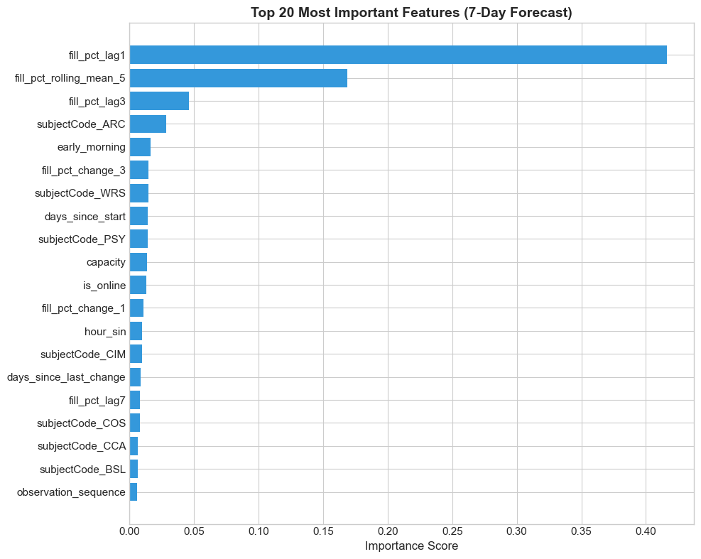
Modeling
Data Mining
Architecture (ARC) and Psychology (PSY) courses are popular predictors.
Online courses also seem to contribute well to popularity prediction
Notes:
Here we see which features are the most important when trying to predict 7 day fill rate forecast.
The calculated fill percentage correlates well with prediction but interestingly
we see that architecture and psychology courses (marked by ARC and PSY) is popular, early morning courses and

Slide 21
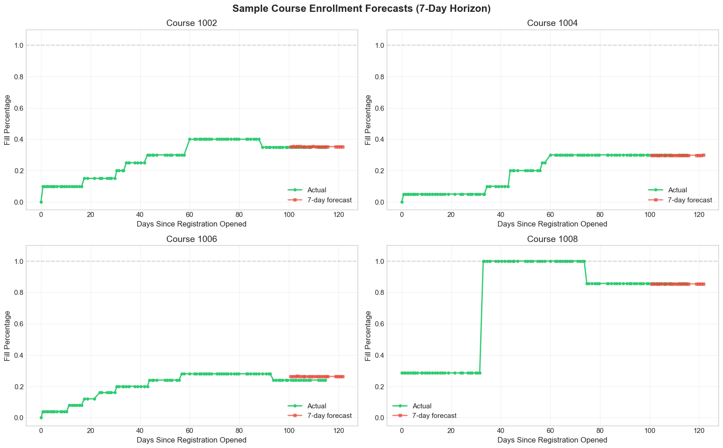
Modeling
Data
Mining

Slide 22
Course Popularity Classification by Levels
Modeling
Data Mining
Popularity metrics for ranking courses
Created a composite popularity index for courses based on how quickly and how fully they fill, including waitlist and early rush signals.
Calculate Time-to-Fill Score (days to 90% capacity)
Measure how many days each course takes to reach 90% capacity and convert this into a score where faster-filling courses are more popular.
Popularity metrics summary
Calculate these metrics for 11,203 courses, providing a detailed popularity profile that includes final fill rate, velocity, time-to-fill, waitlist demand, early rush, and an overall composite score.

Slide 23
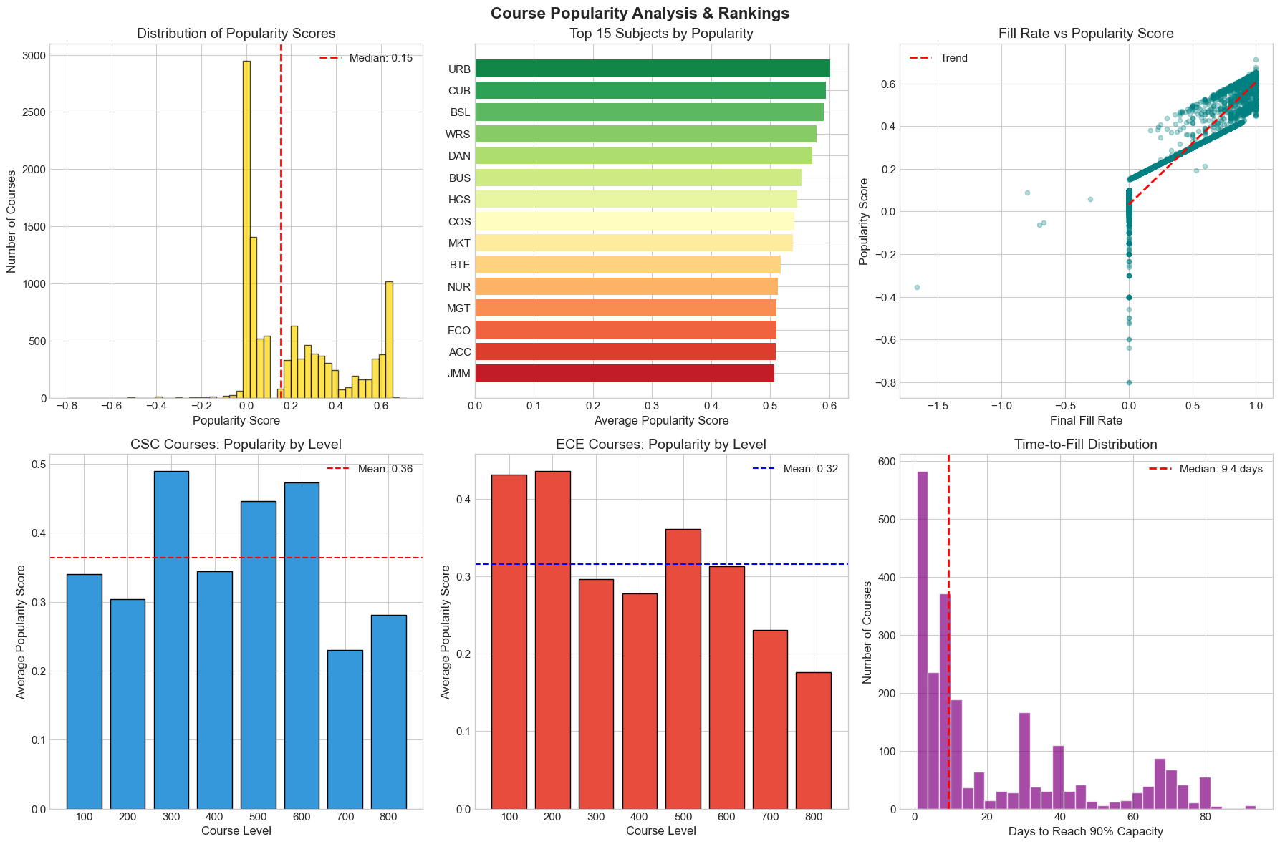
Modeling
Data Mining

Slide 24
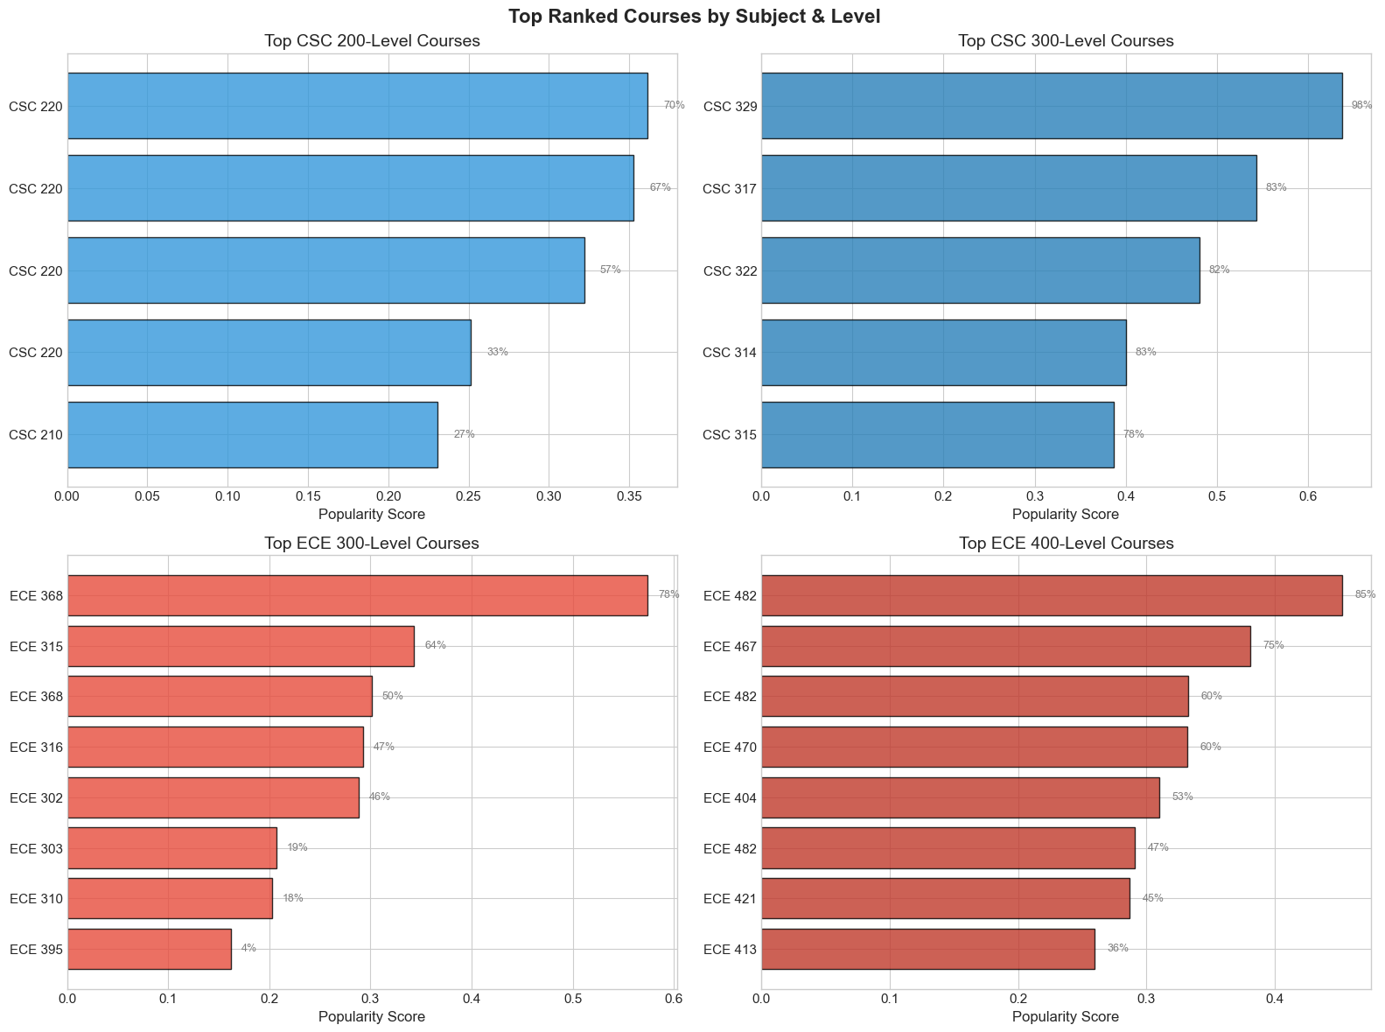
Modeling
Data Mining

Slide 25
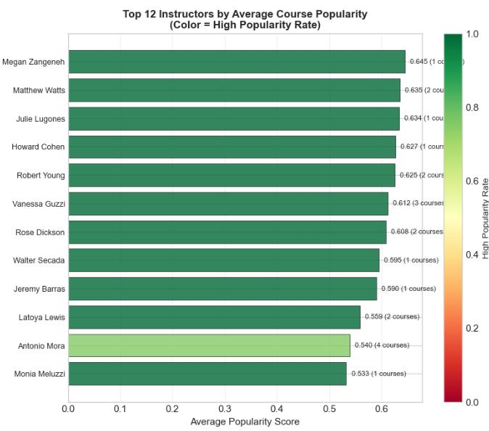
Modeling
Data Mining

Slide 26
Table of Contents
Data Mining
1.
Introduction & Motivation
2.
Cleaning & Preprocessing
3.
Feature Engineering
4.
Modeling
5.
Conclusion

Slide 27
Conclusion + Future Directions
Conclusion
Data Mining
Our analysis provides metrics that can guide resource allocation and improve course selection planning for student with the potential to reduce burden on advisors due to better planning.
Potential Future Avenues:
→ Add notifications for courses with unusually low or high enrollment
→ Flag courses that may benefit from targeted marketing and outreach
Notes:
Admin: Allows administrators to reach out to lecturers in advance when additional courses are needed to be opened.
Advisors: this reduces burden by answering the most common student question: 'Do I need to register for this today, or can I wait?'

Slide 28
References
Conclusion
Data Mining
Advisor to student ratio/caseload resources. NACADA. (n.d.). https://nacada.ksu.edu/Resources/Clearinghouse/View-Articles/Advisor-to-Student-Ratio-Caseload-Resources.aspx
Amos, D. (2024, March 28). A practical introduction to web scraping in Python. Real Python. https://realpython.com/python-web-scraping-practical-introduction/
Digest of Education Statistics, 2021. National Center for Education Statistics (NCES) Home Page, a part of the U.S. Department of Education. (n.d.). https://nces.ed.gov/programs/digest/d21/tables/dt21_326.10.asp
University of Miami (2021). CaneLink. https://canelink.miami.edu/

